Slide 1

Final Project:
"Not every DHCP server is your friend"
Made By:
Ammar Yaser

Slide 2

DHCP Spoofing, DHCP Snooping, and Port Security: Protecting Your Network
Securing your network infrastructure from common but potent threats like DHCP spoofing is paramount in today's interconnected world. This presentation will explore the vulnerabilities of DHCP and how strategic implementations of DHCP Snooping and Port Security can fortify your defenses.

Slide 3



What is DHCP and Why Does It Matter?
Automated Configuration
Scalability
Vulnerability
DHCP (Dynamic Host Configuration Protocol) automatically assigns IP addresses and other network settings to devices, simplifying network management.
It makes network configuration effortless, especially in large and dynamic environments with many devices.
Despite its utility, DHCP lacks built-in authentication, making it susceptible to malicious exploitation.
DHCP is a fundamental protocol for modern networks, but its lack of inherent security mechanisms creates significant vulnerabilities that must be addressed.

Slide 4

The Threat: What is DHCP Spoofing?
DHCP spoofing is a severe cyberattack where a rogue DHCP server impersonates the legitimate one, distributing fraudulent network configurations to client devices.
Consequences of a successful DHCP spoofing attack are dire:
Data interception
Network disruption
Credential theft
Man-in-the-middle attacks
Attackers can redirect traffic through their own machines, gaining unauthorized access to sensitive information and control over network communications.

Slide 5
How DHCP Spoofing Works: The Attack Flow
01
02
DHCP Starvation
Legitimate Server Denial
The attacker floods the network with fake DHCPDISCOVER requests, exhausting the legitimate DHCP server's IP address pool.
The real DHCP server runs out of available addresses, preventing new, legitimate clients from obtaining network configurations.
03
04
Rogue Server Response
Client Compromise
The attacker's rogue DHCP server then responds to subsequent client requests with malicious DHCPOFFER packets.
Clients unknowingly accept these harmful settings, leading to compromised network access and potential data exposure.
This multi-stage attack highlights the need for robust network defenses to prevent IP address exhaustion and unauthorized DHCP responses.

Slide 6
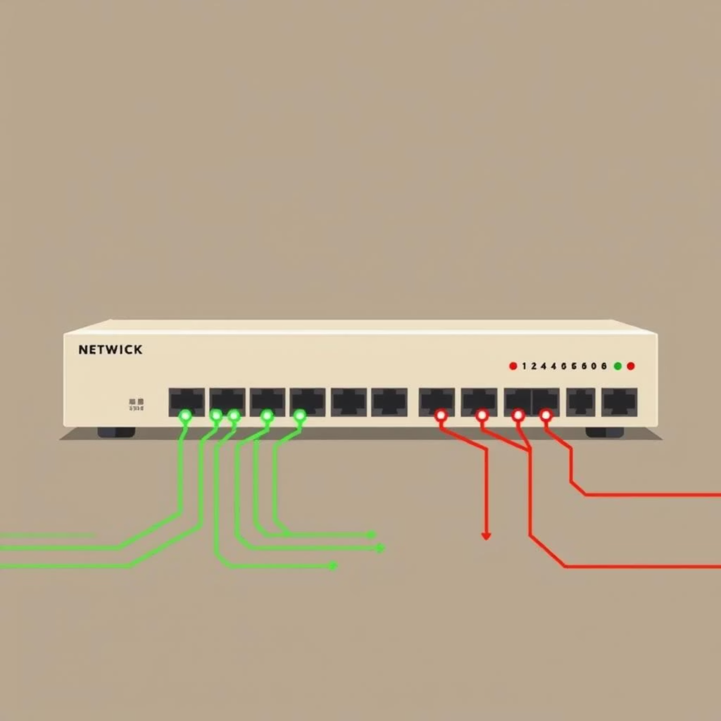
DHCP Snooping: The First Line of Defense
DHCP Snooping is a crucial switch security feature that monitors DHCP traffic to prevent rogue DHCP servers.
It maintains a binding table of trusted IP-MAC address pairs.
Ports are classified as Trusted (e.g., connected to legitimate DHCP servers) or Untrusted (client-facing ports).
DHCP responses originating from untrusted ports are blocked unless they validate against the binding table, effectively preventing rogue servers.
Commands like show dhcp-security binding are essential for validating the snooping database and identifying potential anomalies.

Slide 7



Beyond Snooping: ARP Inspection and IP Source Guard
Dynamic ARP Inspection (DAI)
IP Source Guard
Dependency & Caveats
This feature inspects IP packets on untrusted ports, permitting only traffic with source IP and MAC addresses that match the DHCP bindings.
Both DAI and IP Source Guard heavily rely on the accuracy of DHCP snooping data. Static IPs on untrusted ports might experience connectivity issues without proper configuration.
DAI validates ARP packets against the DHCP snooping binding table, blocking spoofed ARP replies and protecting against man-in-the-middle attacks.
These advanced features layer on top of DHCP snooping, creating a comprehensive defense against various network layer attacks.

Slide 8
Port Security Considerations & Best Practices
Effective implementation of DHCP snooping and port security requires careful planning and configuration:
Default Port Status: Generally, trunk ports should be configured as Trusted, and access ports as Untrusted.
Static IP Devices: Devices with static IP addresses or critical infrastructure services (e.g., servers) should be placed on Trusted ports to prevent unintended blocking.
802.1X Integration: When combining IP Source Guard with 802.1X authentication, ensure compatibility, often by using single supplicant mode.
Continuous Monitoring: Regularly monitor logs and DHCP binding tables for any anomalies or signs of suspicious activity.
Adhering to these best practices ensures that your network remains secure without disrupting legitimate operations.

Slide 9

Real-World Example: Configuring DHCP Snooping on a Switch
Key Configuration Steps:
Authorize DHCP Server IPs: Define the legitimate DHCP server(s) that the switch will trust.
Trust Uplink Ports: Configure ports connected to authorized DHCP servers as trusted.
Enable on VLANs: Activate DHCP snooping on all VLANs where client devices reside.
Aruba Switch Example Commands:
switch(config)# dhcp-snooping authorized-server 10.0.0.10
switch(config)# interface 1/1/1
switch(config-if)# dhcp-snooping trust
switch(config-if)# exit
switch(config)# dhcp-snooping vlan 10,20,30
switch(config)# interface range 1/1/1 -4
switch(config)# switchport port-security mac-address sticky
This configuration prevents rogue DHCP servers from operating and ensures clients receive valid IP assignments, protecting against common network attacks.

Slide 10


The Impact: Why These Protections Matter
Prevents Traffic Hijacking
Maintains Network Integrity
Blocks attackers from redirecting network traffic, safeguarding data and preventing denial-of-service.
Ensures only authorized DHCP servers assign IPs, preserving the authenticity and reliability of network services.
Protects Sensitive Data
Essential for Enterprise
Mitigates risks of data interception and credential theft by controlling network access points.
Crucial for large, complex networks with numerous devices, ensuring secure and stable operations.
Implementing these security measures provides a foundational layer of defense, making your network more resilient against internal and external threats.

Slide 11

Conclusion: Secure Your Network with DHCP Snooping & Port Security
Key Takeaways:
DHCP Spoofing is a Real Threat: It exploits DHCP vulnerabilities, leading to serious network compromises.
Layered Defense is Key: DHCP snooping, coupled with ARP inspection and IP Source Guard, creates a robust defense.
Configuration Matters: Proper port classification and consistent configuration are vital for effective protection.
Stay Vigilant: Regular monitoring, auditing, and updates are necessary to maintain a secure network posture against evolving threats.
By understanding and implementing these critical security measures, you can significantly enhance your network's resilience and safeguard your digital assets.

Slide 12
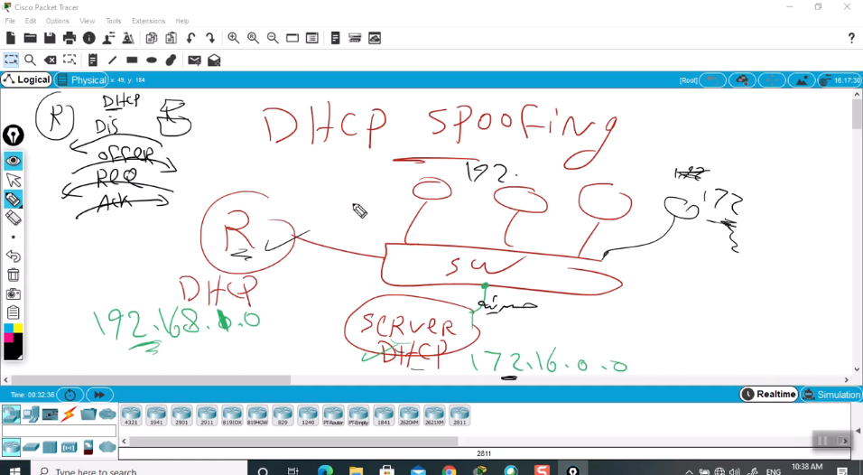

Slide 13
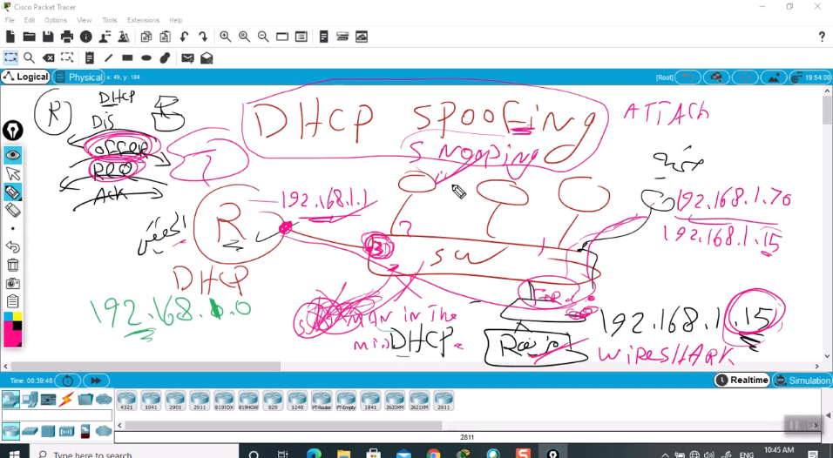

Slide 14
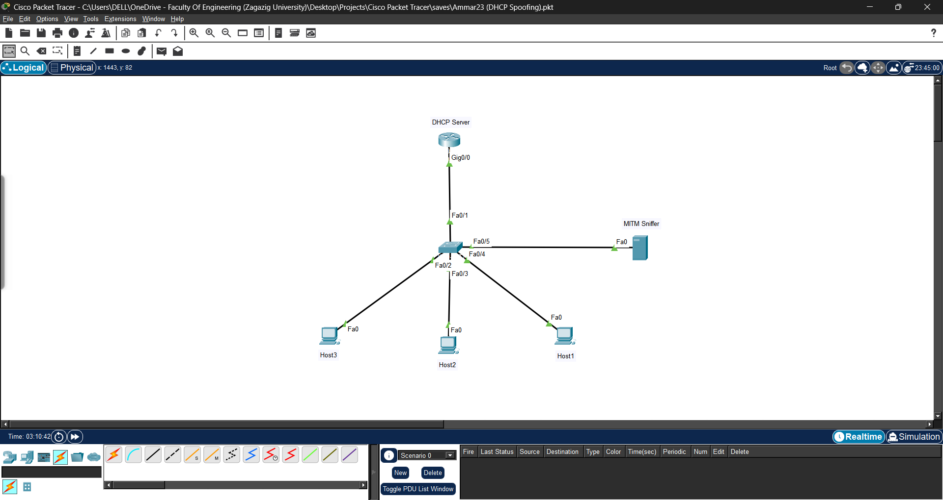

Slide 15
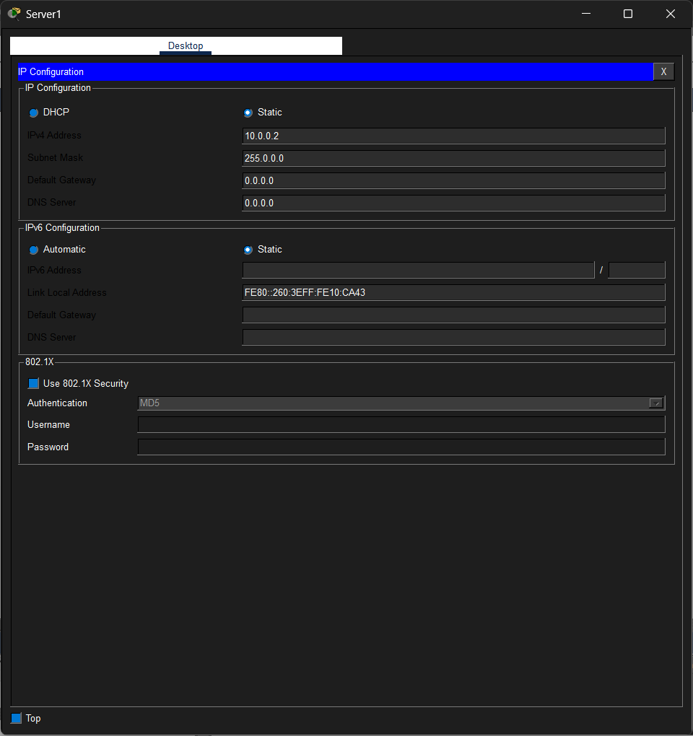
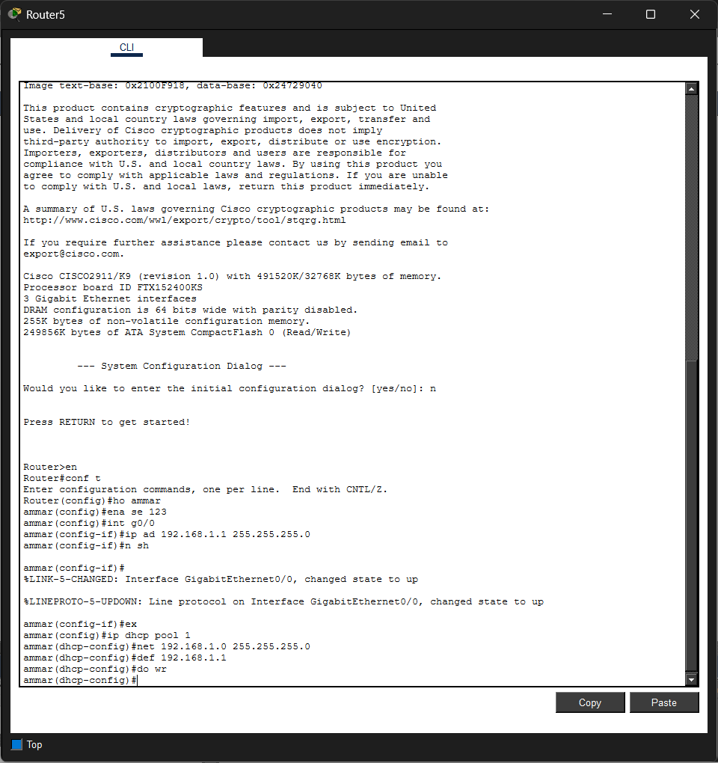

Slide 16
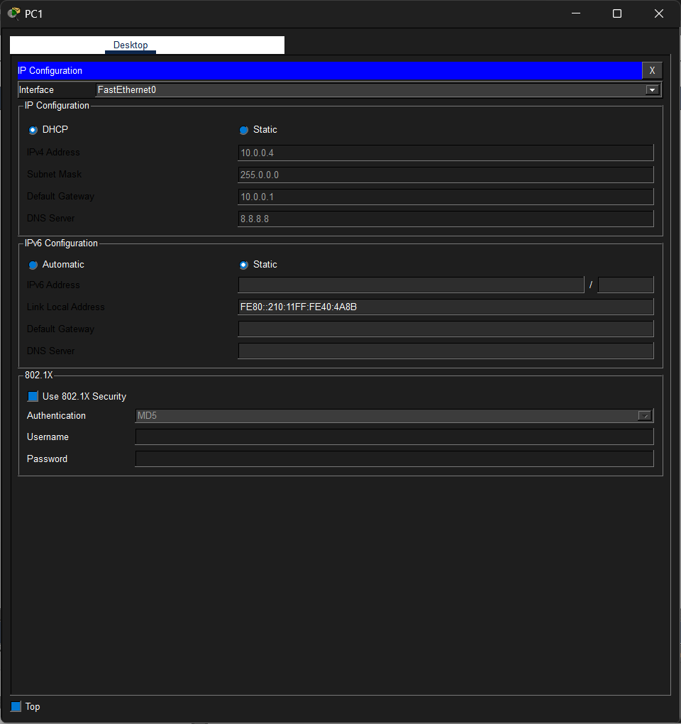
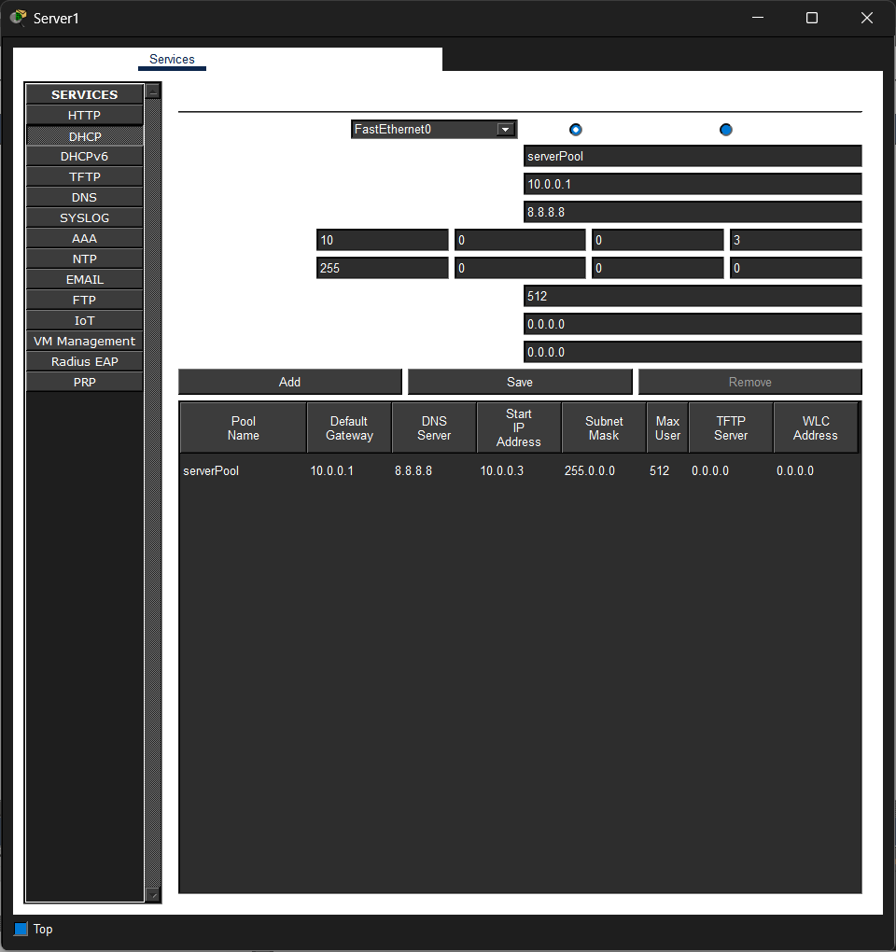

Slide 17
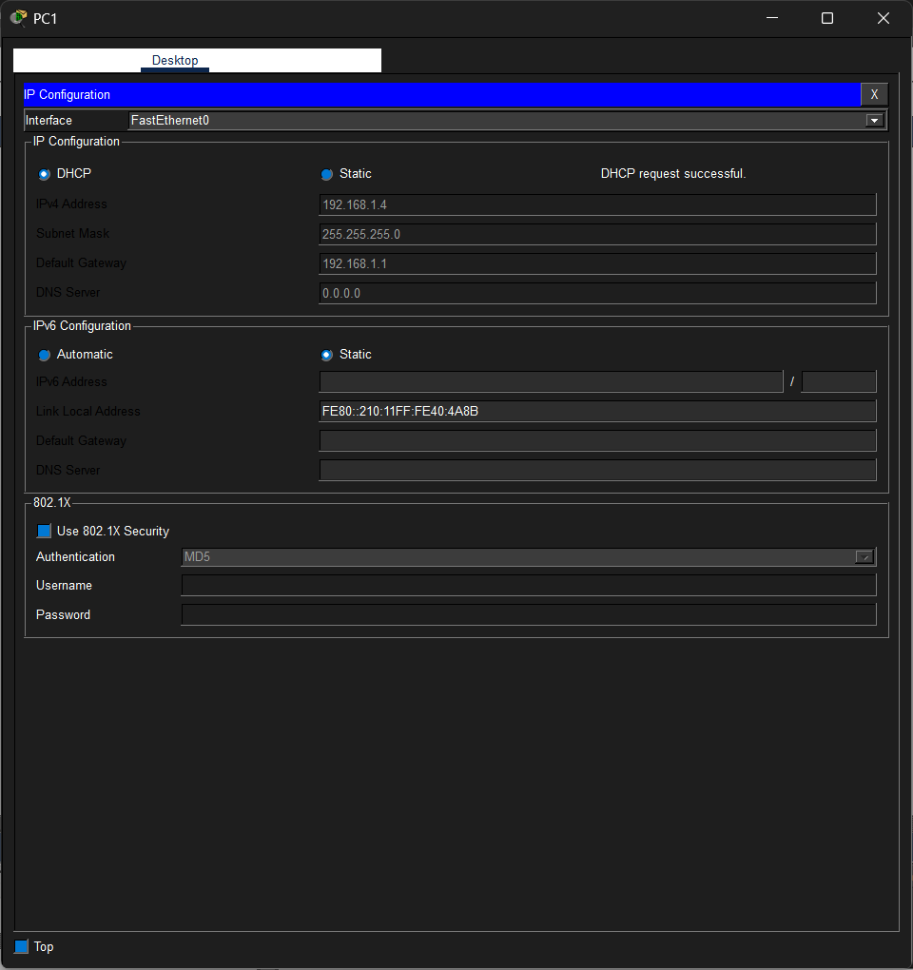
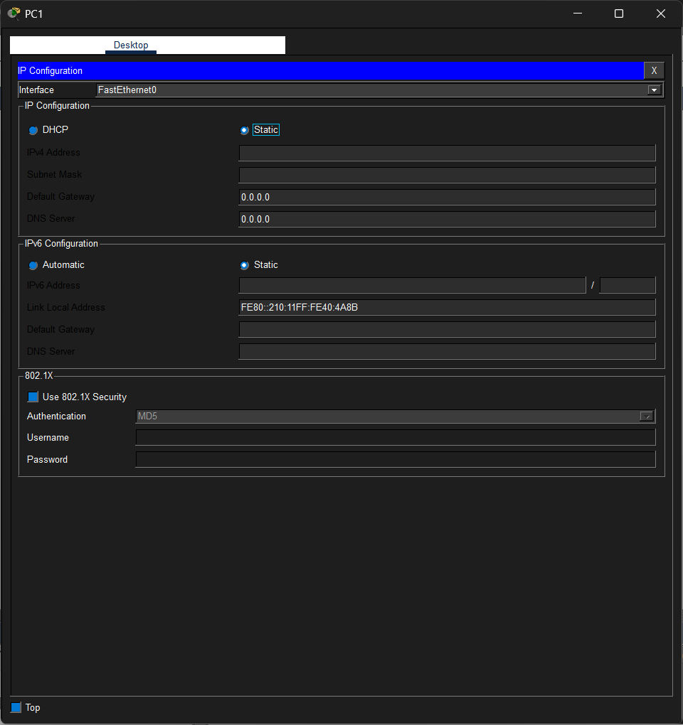

Slide 18
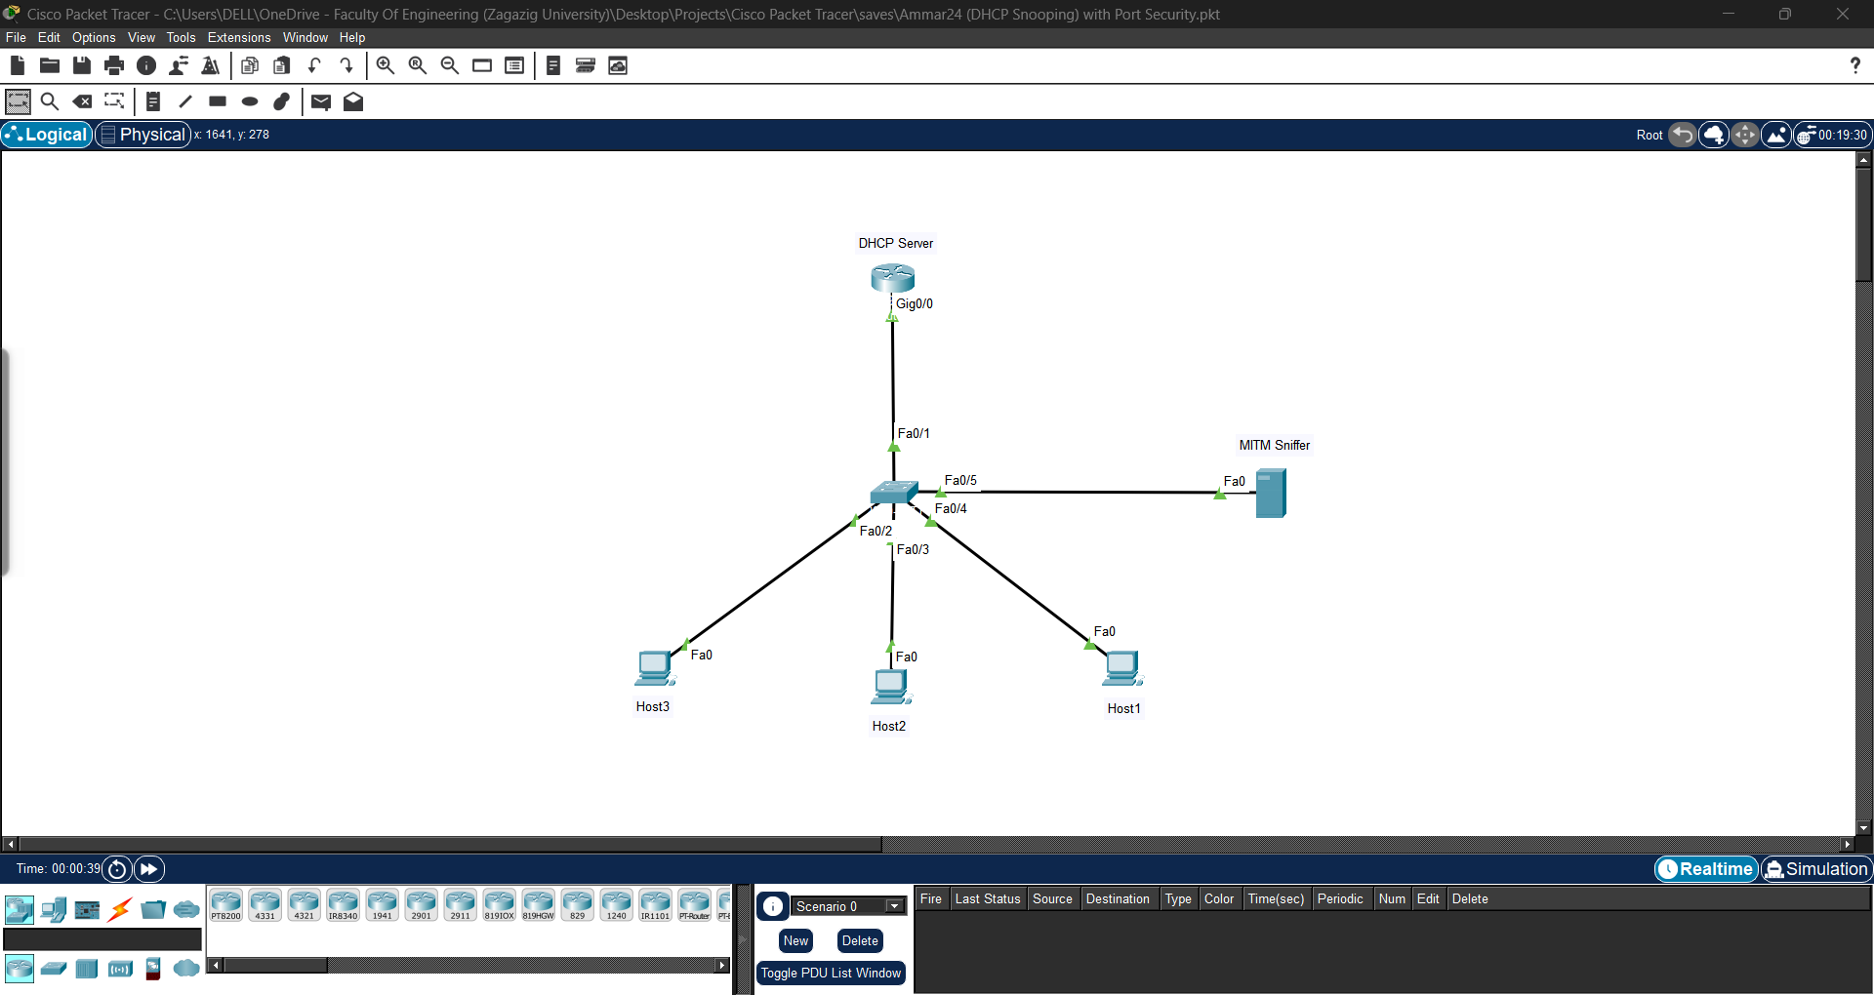

Slide 19
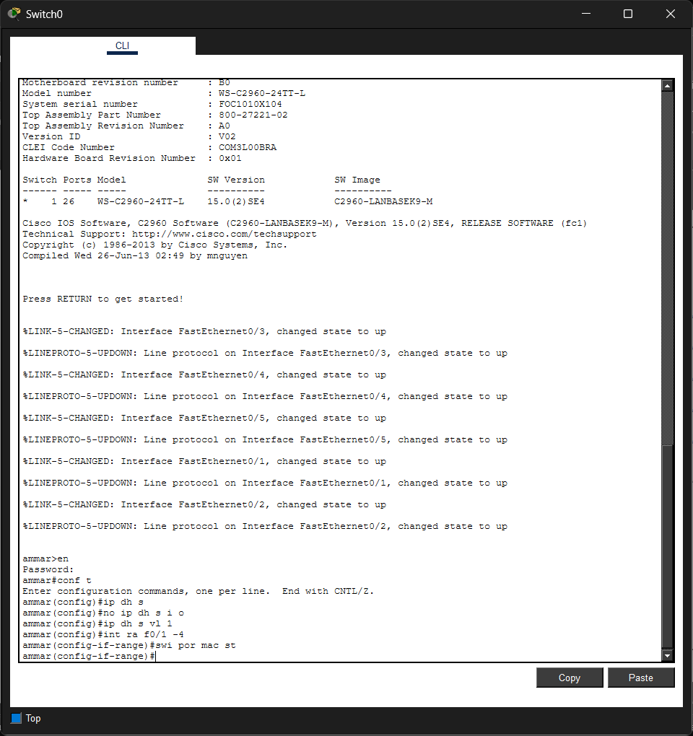
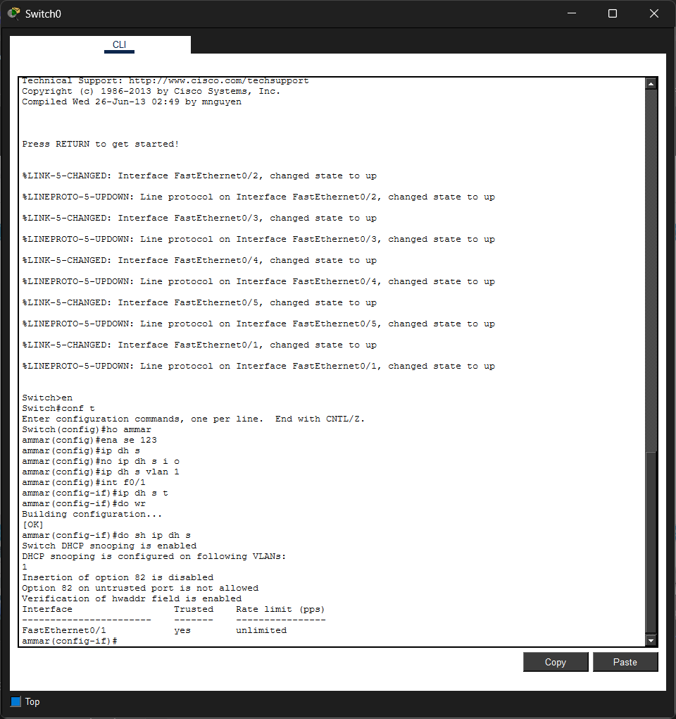

Slide 20
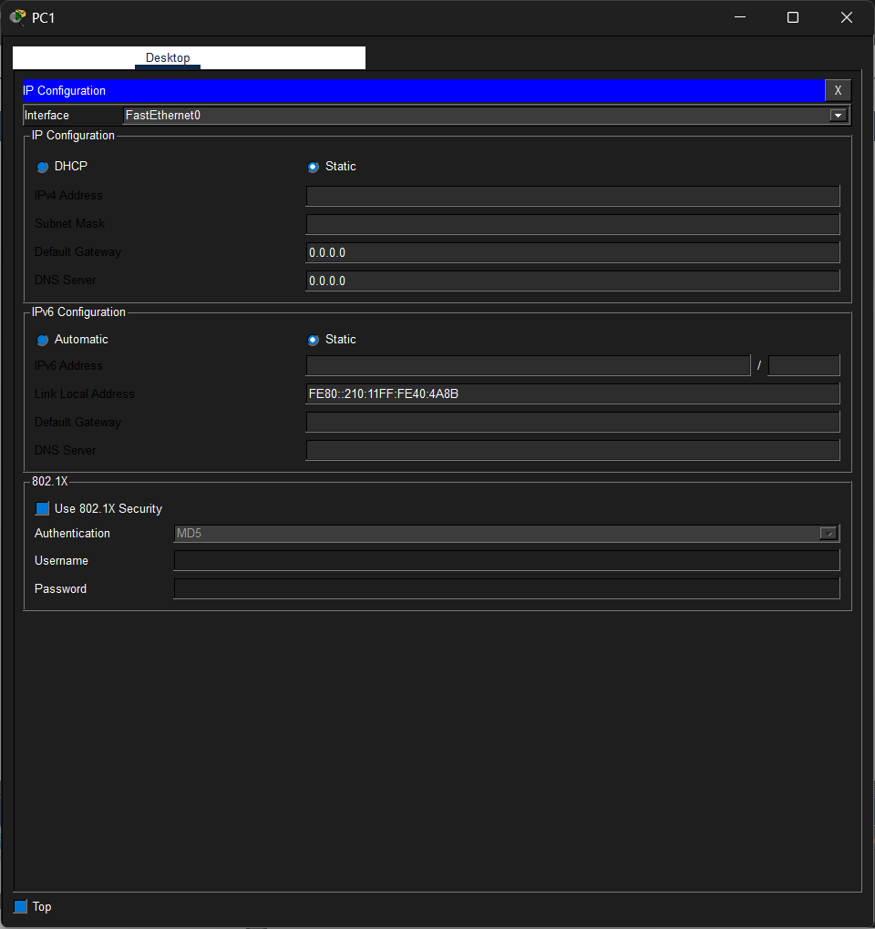
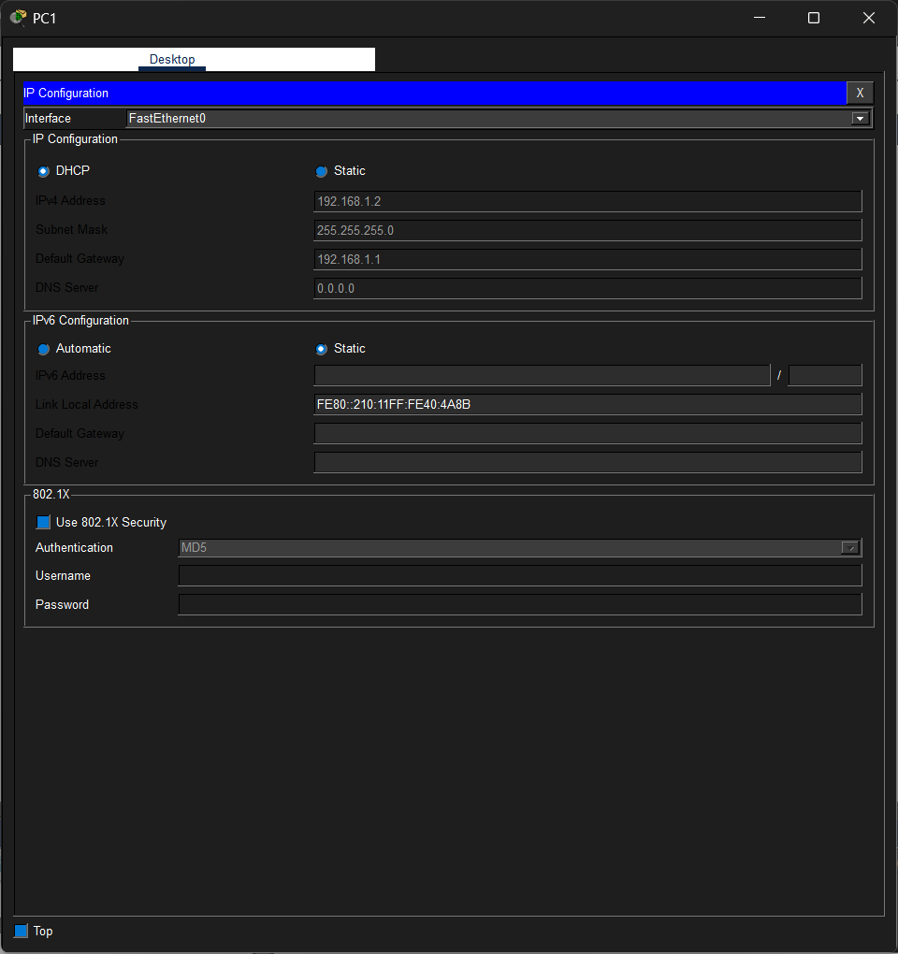

Slide 21



Slide 22
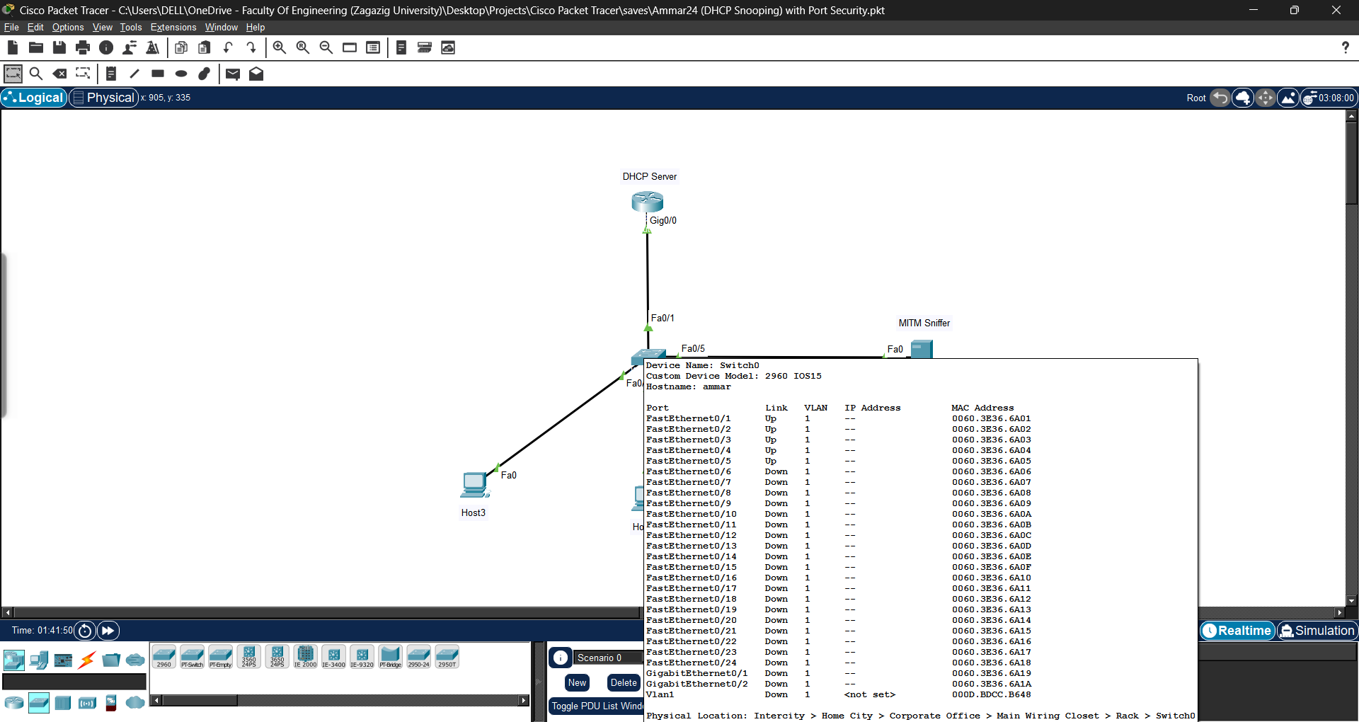

Slide 23
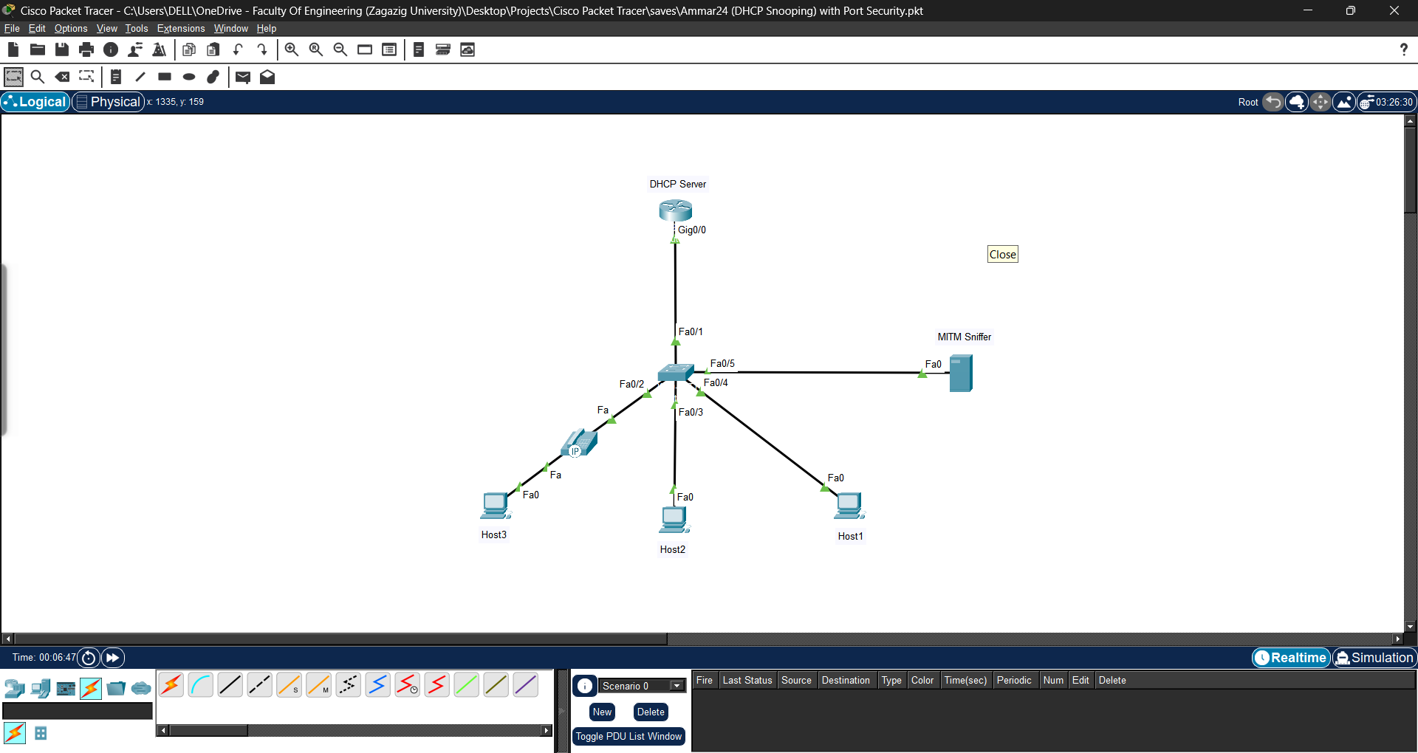

Slide 24
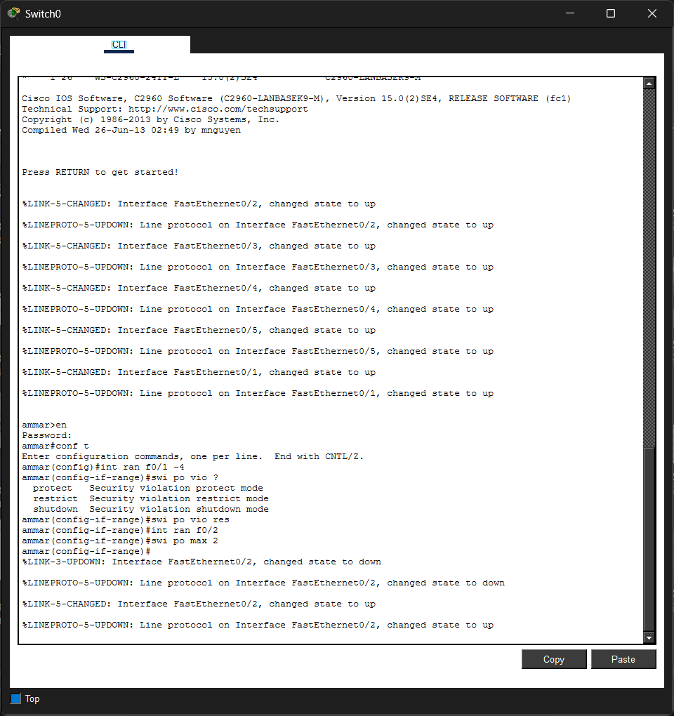
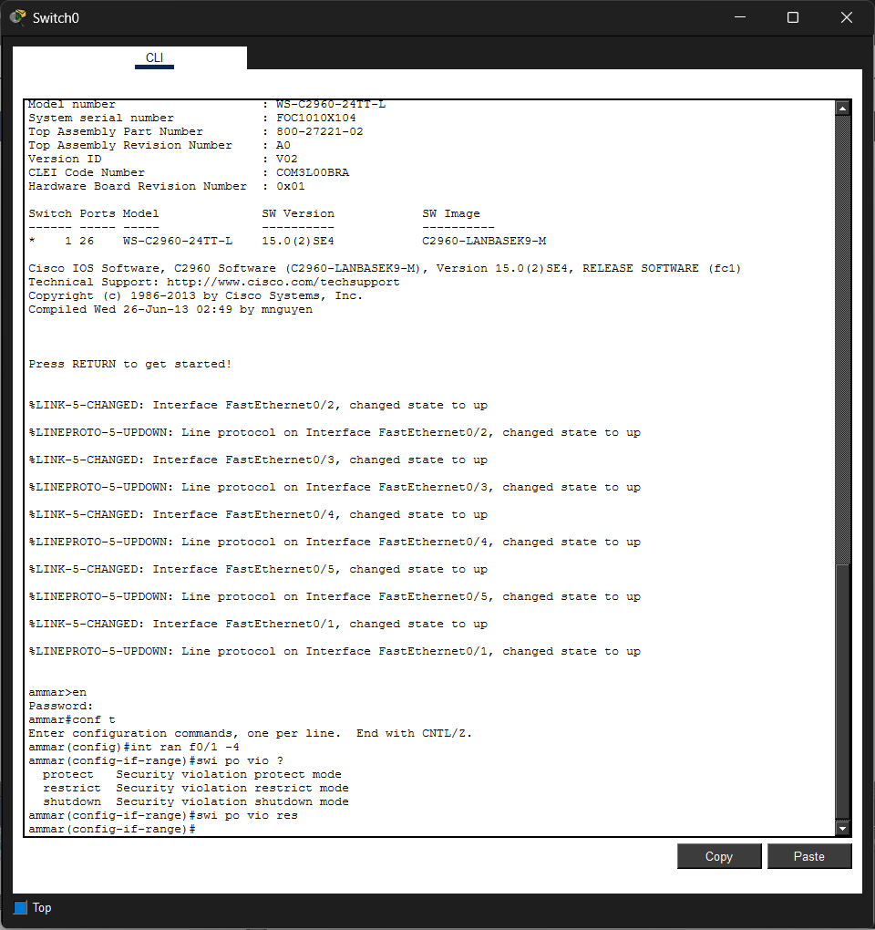

Slide 25

Always remember:
“Risks come from not knowing what you’re doing”
Thank you

